Slide 1
AT A GLANCE
PROMOTIONAL
£171.9K
34,437
PERFORMANCE
TOTAL PROMOTED REVENUE
PROMOTED TRANSACTIONS
ANALYSIS
48
PRICE REDUCTION
TOTAL PROMOTIONS RUN
BEST ROI PROMOTION
2026 Annual Review | Retail Grocery Sector
Promotional activity across Beverages, Snacks, Dairy, Frozen, Fresh Produce & Bakery categories
Prepared by: Tom Green

Slide 2
KEY FINDINGS
What the data tells us
01
02
MEAL DEAL — HIGHEST REVENUE
PRICE REDUCTION — BEST ROI
Meal Deal generated £45.6K in promotional revenue, making it the top performer by total sales value across all promotion types.
Price Reduction delivered a ROI of 5.67, meaning every £1 of discount generated £5.67 in revenue — the most efficient promotion type.
03
04
FROZEN — TOP RESPONDING CATEGORY
SEASONAL PEAKS IN MAY & JULY
The Frozen category generated £41.8K in promoted revenue, significantly outperforming all other categories including Beverages (£29.8K).
Promotional revenue peaked in May and July, with a secondary surge in November and December — aligning with summer and festive trading periods.

Slide 3
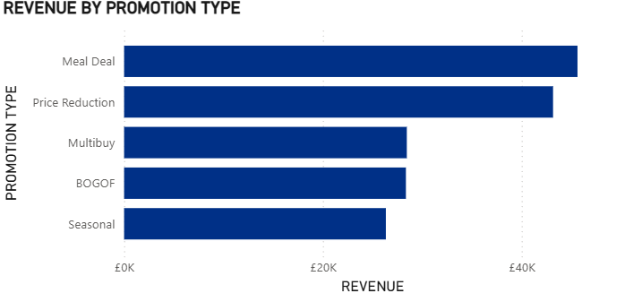
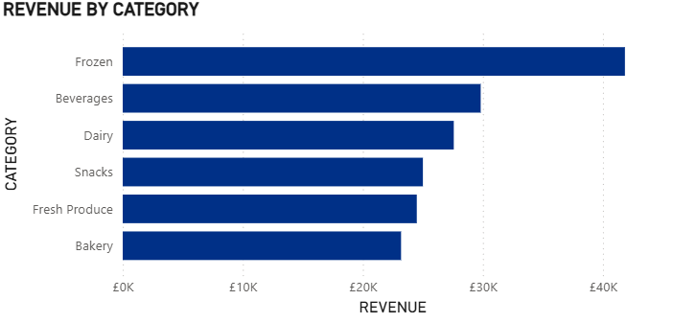
REVENUE ANALYSIS
Revenue by Promotion Type & Product Category
💡 Meal Deal and Price Reduction together account for 57% of all promotional revenue.
💡 Frozen category outperforms Beverages by £12K — a key opportunity for targeted promotions.

Slide 4
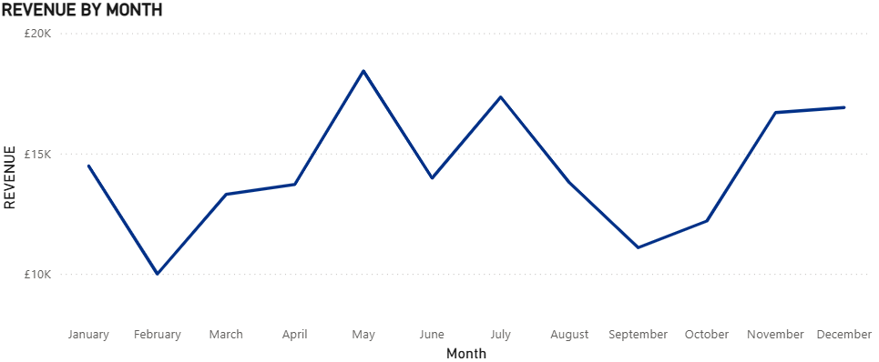
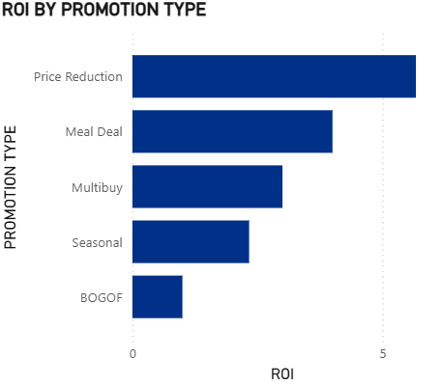
SEASONAL TRENDS & ROI
When promotions work best and which deliver the greatest return
💡 May and July are peak months — promotional spend should be concentrated here to maximise return.
💡 BOGOF has the lowest ROI — consider replacing with Price Reduction for better efficiency.

Slide 5
RECOMMENDATIONS
Data-driven actions for 2026 promotional planning
01
02
PRIORITISE PRICE REDUCTION
REVIEW BOGOF STRATEGY
With the highest ROI of 5.67, Price Reduction should be the default promotional mechanic. Increase frequency and apply across high-volume categories such as Frozen and Beverages.
BOGOF delivers the lowest ROI at 1.2. Evaluate whether deep-discount mechanics are driving incremental volume or simply cannibalising full-price sales. Consider replacing with Multibuy.
03
04
CONCENTRATE SPEND IN PEAK MONTHS
DOUBLE DOWN ON FROZEN & BEVERAGES
May, July, November and December are the strongest months for promotional revenue. Align promotional calendars and budgets to front-load activity into these periods.
These two categories account for the highest promotional revenue. Develop category-specific promotional plans that target these first to maximise return on promotional investment.

